Slide 1
Electronic Voting Machine with fingerprint and facial recognition
Guided By;
Kanagaraj G
(AP/ECE)
Presented by;
Bharath G [620118106015]
Kalaiarasan M.K [620118106034]
Mubarak Ali S.Y [620118106056]
Ajay R [620118106003]

Slide 2
Abstract:
Electronic Voting Machine (EVM) retains all the characteristics of voting by ballot papers, while making polling a lot more expedient.
Considerable amount of time, man power and money is saved as it is extremely fast and reliable.
Voting secrecy is also maintained without use of ballot paper
To ensure security and rights of the citizens we implemented finger print sensor and facial recognition for verification of the voter.

Slide 3
Literature Survey:
Sl.No | Paper Title and Author | Year of Publication | Advantages | Drawback
1 | Electronic Voting Machine. -D. Ashok Kumar | 2012 | Better than Ballot voting system. | The difficult task is the complexity of system.
2 | High Performance Electronic Voting Machine (EVM) Implementation Using ARM Cortex M3 . -Avinashi N J | 2020 | Final vote count display are password protected. | Not enough security.
3 | Design and implementation of convenient and compulsory voting system using finger print sensor and GSM technologies . -Shubhranil Chakraborty | 2020 | FP secured, GSM based data sharing & reduced Vote counting time. | Suitable for Small Scale
4 | Smart Online Voting System. -Ganesh Prabhu S | 2021 | This system doesn’t require any hardware | Servers need to be secure and withstand against various attacks
5 | The Next Gen Election: Design and Development of E-Voting Web Application. -Raghav Chhabra | 2020 | Database is stored in an undisclosed location Officials of the Election Commission of India know the exact location | Time involvement is high. Heavy and repetitive task of vote management.

Slide 4
Existing System:
The existing voting system, doesn’t have person image identification, so that there are chances to misuse the others rights.
counting of votes takes some weeks after voting so insider or criminal can use the clip-on device to change the votes recorded in EVM.
The limitation of this system is present in its fingerprint acquisition process.
Since the finger print gets tampered due to age, work and other factors such as skin problems, wet hands. so that the system may lags to recognize them.
Also this system contains two parts, control unit and ballot unit, so its hard to maintain these two parts.

Slide 5
Existing System:

Slide 6
Proposed System:
In this project, an attempt has been made to the development of an authenticated electronic voting system using fingerprint and facial recognition.
The two-fold authentication system improves the security of the voting process and reduces the chances of a corrupt election process.
The facial recognition process utilizes the Local Binary Pattern Histogram and Support Vector Machine process to scan, store and recognize faces efficiently.
A private server (cloud or local) is used to store both the user data and the election results separately.
This reduces the chances of external manipulation of the election results.

Slide 7
Advantages:
It improves the security and efficiency of the voting process.
Data is stored in both local and separate memory so manipulation of votes can be easily found.
Vote counting is digitalized so, counting process becomes lot more easier.

Slide 8
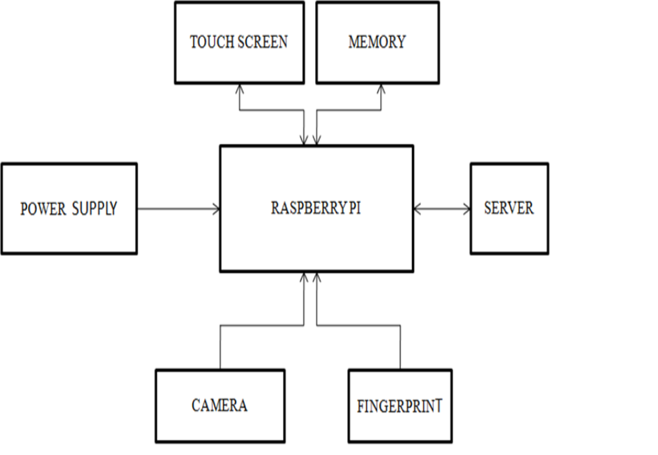
Proposed System:

Slide 9
Thank You

